Slide 1
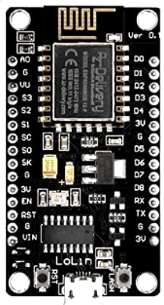
mqttTamBox
https://github.com/etxbct/mqttTamBox/
Keypad
Display
i2c
i2c
SCL
SCL
PCF8574
PCF8T
SCL
SDA
SDA
SDA
VCC
VCC
VCC
GND
GND
GND
D0
Password reset
D1
D2
3V
G
Buzzer
D5
VCC
D6
I/O
GND
Led12
G
G
GND
VIN
3V
I/O
+5V

